Slide 1









Ad-Hoc-Analysis

Slide 2

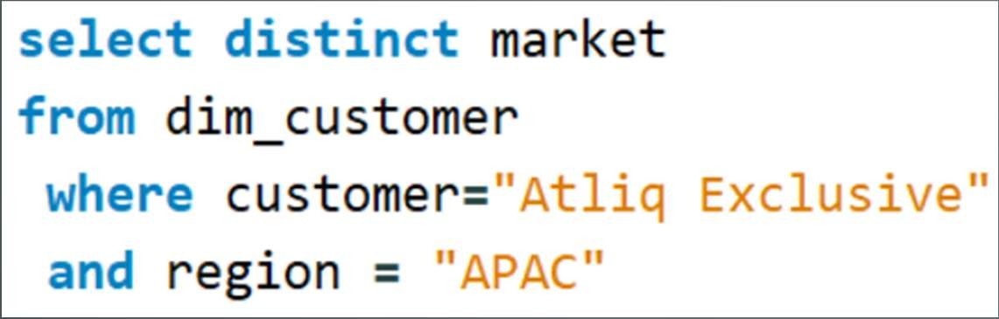
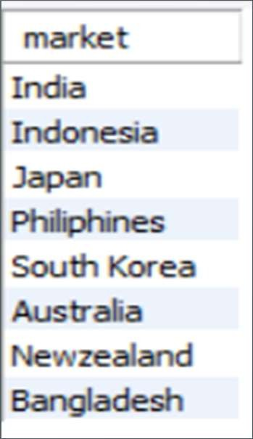
AD_HOC-REQUEST:1
QUESTION:
Provide the list of markets in which customer
"Atliq Exclusive" operates its business in the APAC region
SQL Query
Output

Slide 3
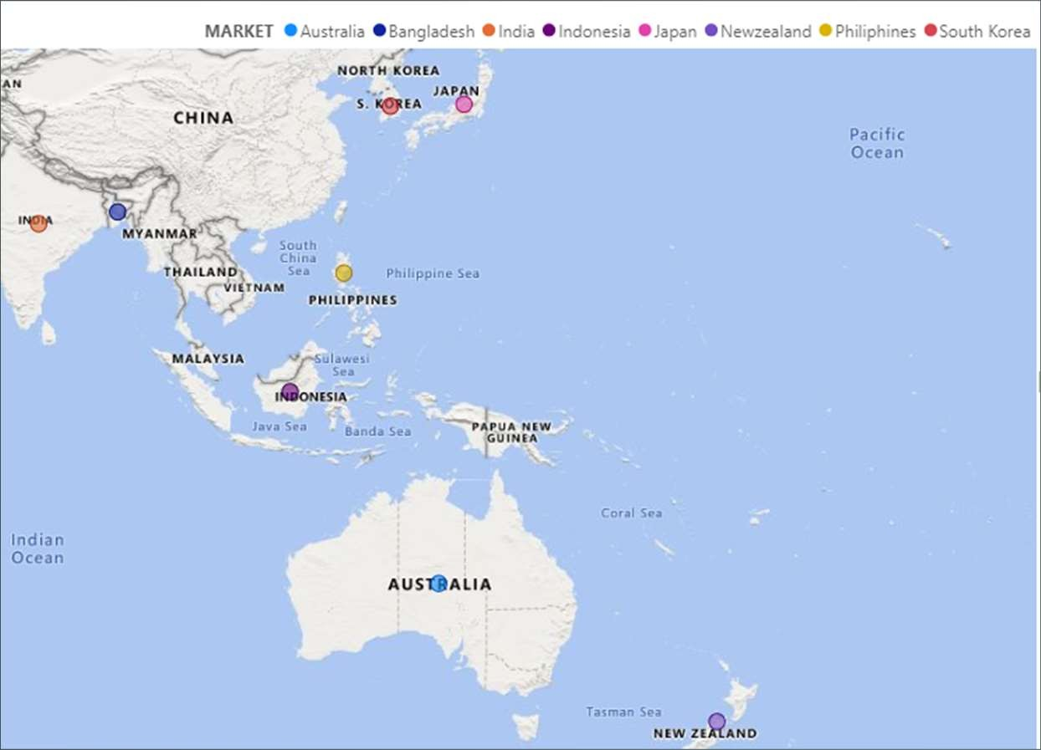
VISUALS-1
Insights
"Atliq Exclusive" has a presence in several countries across the APAC region, including India, Indonesia, Japan, the Philippines, South Korea, Australia, New Zealand, and Bangladesh.
It reflects a robust market presence and adaptability to different cultural and economic contexts in the Asia-Pacific region.

Slide 4
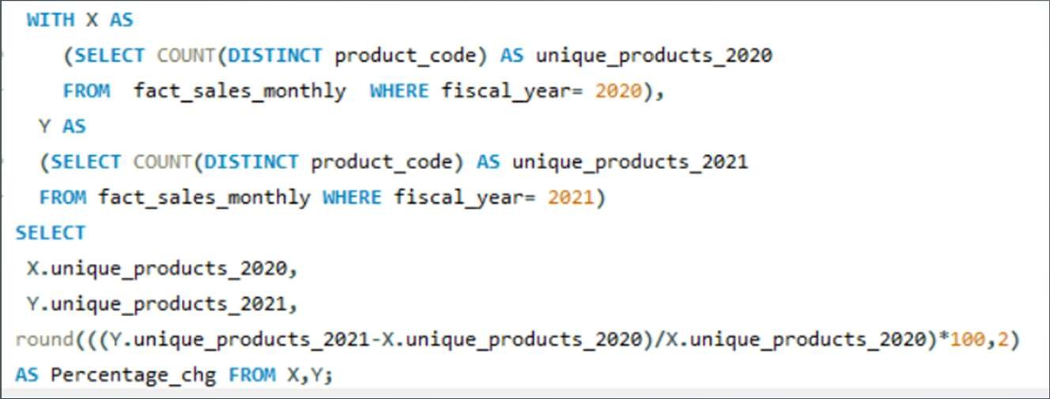
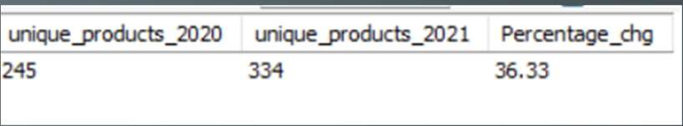
AD_HOC-REQUEST:2
QUESTION:
What is the percentage of unique product increase in 2021vs. 2020?
The final output contains these fields, unique_products_2020 unique_products_2021 percentage_chg
SQL Query
Output

Slide 5







VISUALS-2
Insights
Rise in unique_product 2021vs 2020
There was a significant increase in unique products, with 334 in 2021 compared to 245 in 2020.
The percentage change represents a growth of 36.33% in unique products from one year to the next.
245
334
unique_products_2020 unique_products_2021
This substantial increase in unique products suggests a focus on expanding product offerings, which can attract a broader customer base and potentially boost sales and revenue.
It's a positive indicator of business growth and adaptability to changing market demands.

Slide 6
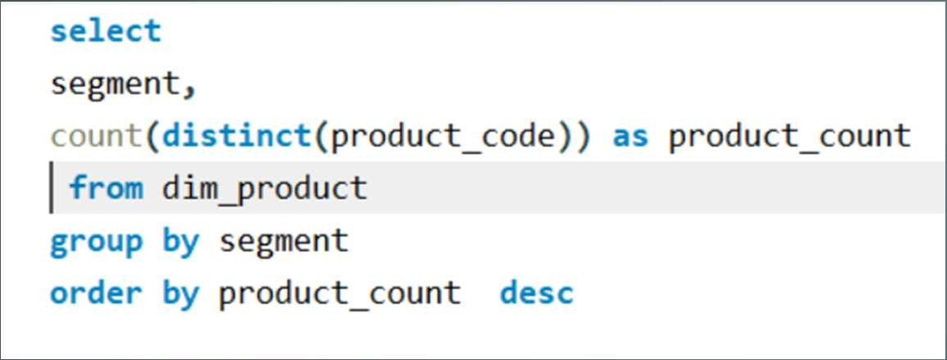
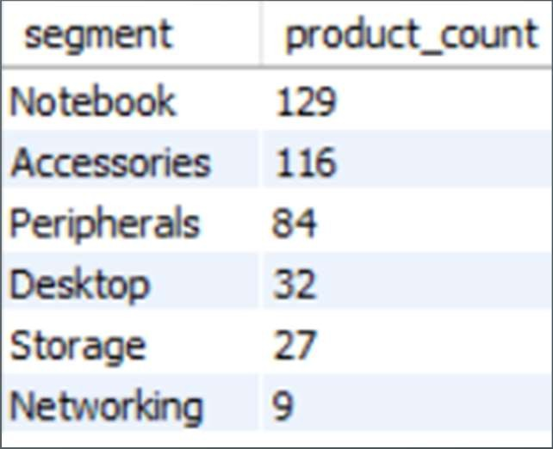
AD_HOC-REQUEST:3
QUESTION:
Provide a report with all the unique product counts for each segment and sort them in descending order of product counts.The final output contains 2 fields, segment product_count
SQL Query
Output

Slide 7














VISUALS-3
Insights
product_count by Segment
Notebook, 129
The "Notebook" segment has the highest product count, with 129 products.
Accessories, 116
The "Networking" segment has the smallest product count with only 9 products.
Peripherals, 84
These insights indicate the diversity and product offerings within each segment, with "Notebook" and "Accessories" offering a wide range of options, while "Networking" has a more limited selection.
Desktop, 32
Storage, 27
The variety in product offerings allows catering to various customer preferences and needs across different segments
Networking, 9

Slide 8
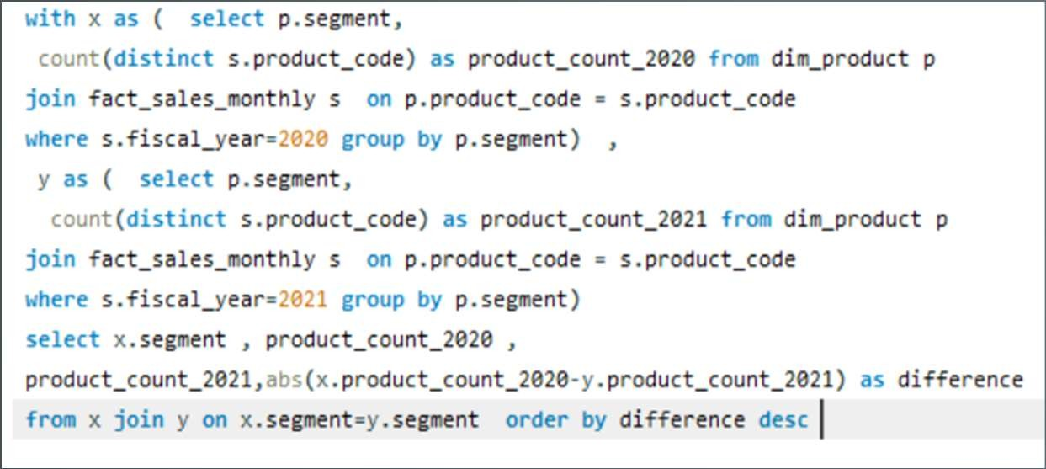
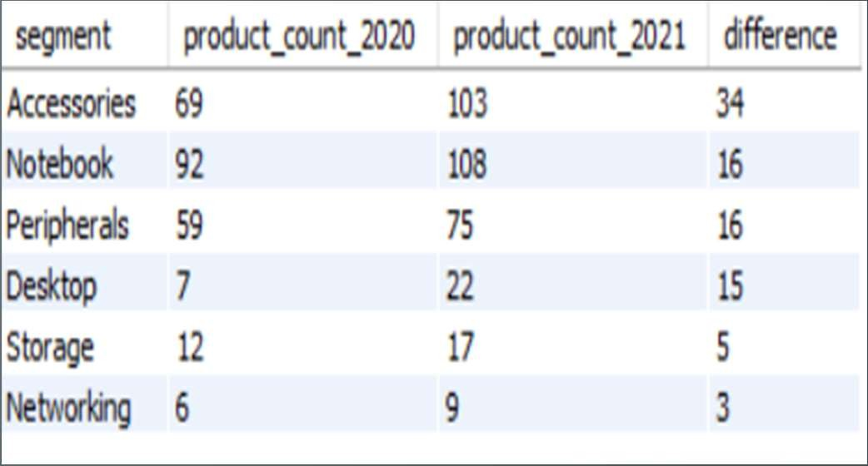
AD_HOC-REQUEST:4
QUESTION:
Follow-up:Which segment had the most increase in unique products in 2021 vs 2020? The final output contains these fields, segment, product_count_2020, product_count_2021, difference
SQL Query
Output

Slide 9

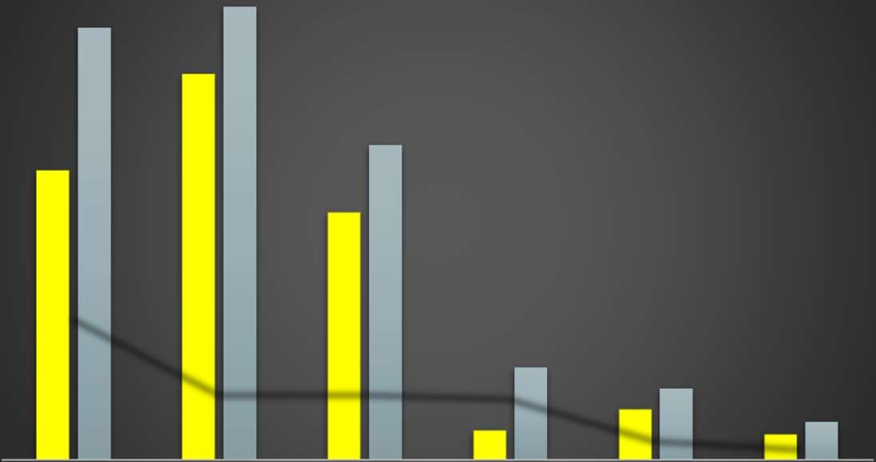
VISUALS 4
Insights
The "Accessories" segment saw a significant increase in product counts, with 34 more products in 2021 compared to 2020.
These insights suggest a general trend of product portfolio growth, particularly in the "Accessories" and "Notebook" segments, which can indicate a strategy to cater to a broader range of customer preferences.
The growth in product variety may enhance market competitiveness and offer customers more choices.
product_count trends of segment
103
108
92
69
75
59
34
22
16
16
12
17
7
15
9
3
Networking difference
5
Storage
6
Accessories
Notebook
Peripherals
Desktop
product_count_2020
product_count_2021

Slide 10
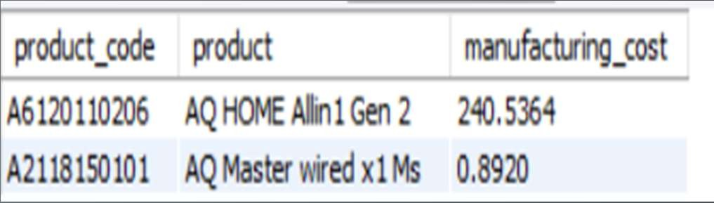
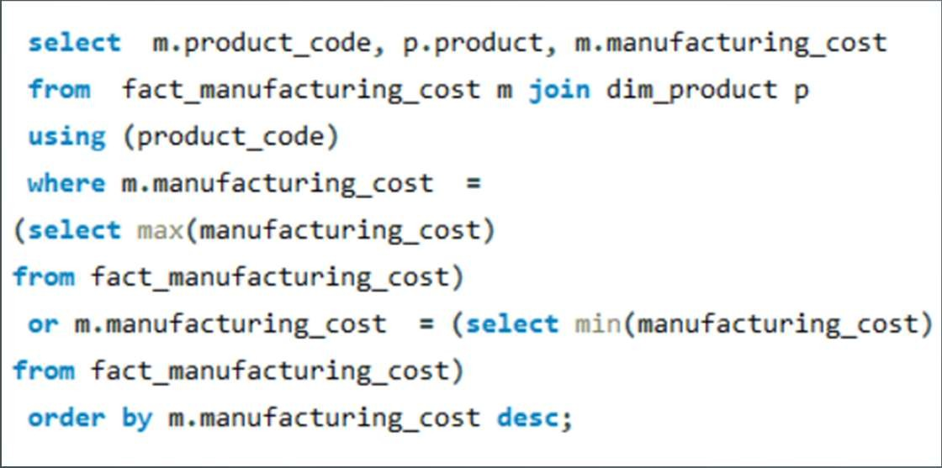
AD_HOC-REQUEST:5
QUESTION:
Get the products that have the highest and lowest manufacturing costs.
The final output should contain these fields product_code, product, manufacturing_cost
Output
SQL Query
Insights
"AQ HOME Allin1 Gen 2" has a relatively higher manufacturing cost of 240.5364.
In contrast, "AQ Master wired x1 Ms" has a significantly lower manufacturing cost of 0.892.

Slide 11
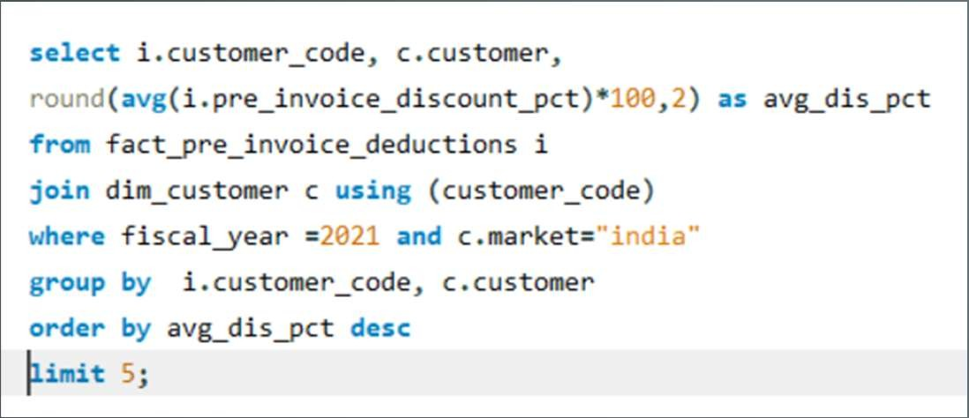
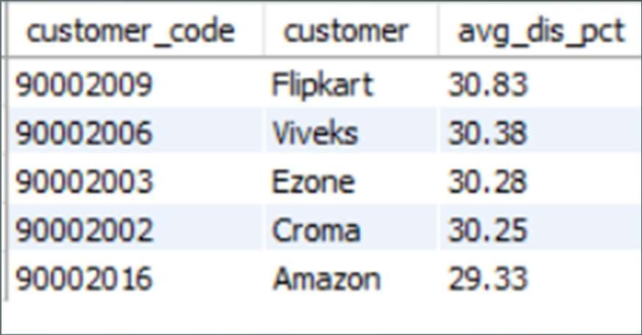
AD_HOC-REQUEST:6
QUESTION:
Generate a report which contains the top 5 customers who received an average high pre_invoice_discount_pct for the fiscal year 2021 and in the Indian market.The final output contains these field customer_code, customer, average_discount_percentage
SQL Query
Output

Slide 12

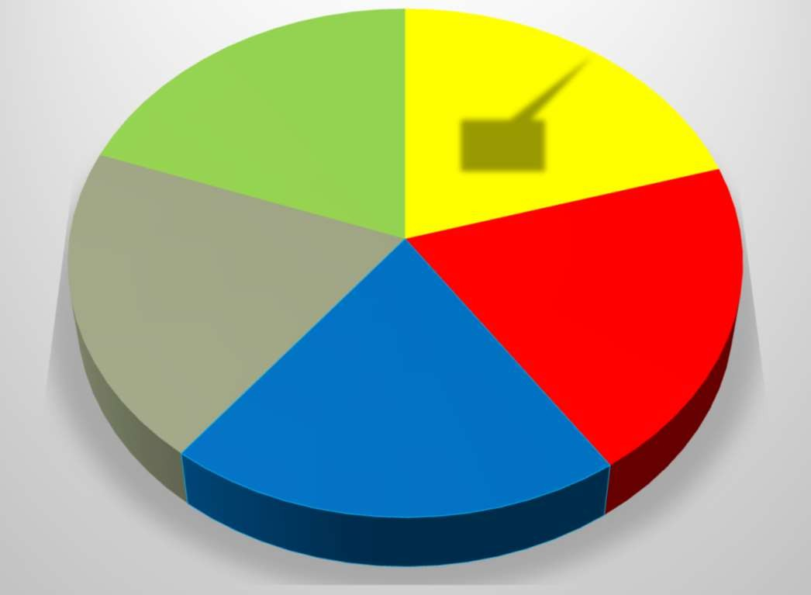

















VISUALS-6
Insights
"Flipkart" has the highest average pre-invoice discount percentage at 30.83%.
"Amazon" has a comparatively lower average discount at 29.33%.
These insights indicate varying discount strategies among customers, with "Flipkart" and "Viveks" offering the highest average discounts, potentially attracting cost-conscious shoppers.
"Amazon" provides relatively lower discounts, suggesting a different pricing strategy or a customer base less sensitive to discounts.
These insights can be valuable for adjusting discount strategies and understanding customer preferences.
customer vs avg_dis_pct
Amazon 20%
Flipkart 20%
Croma 20%
Viveks 20%
Ezone 20%

Slide 13
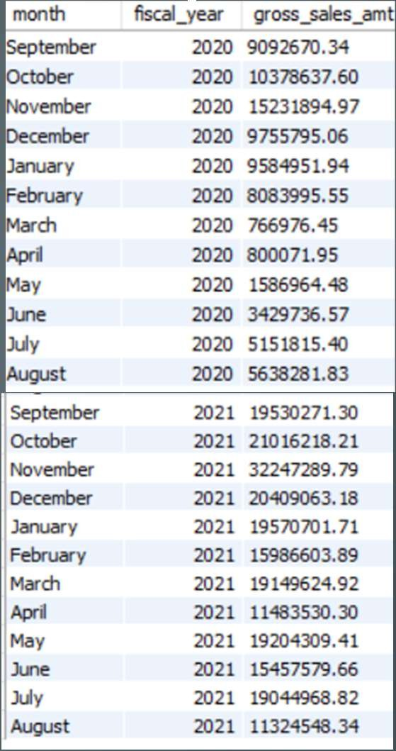
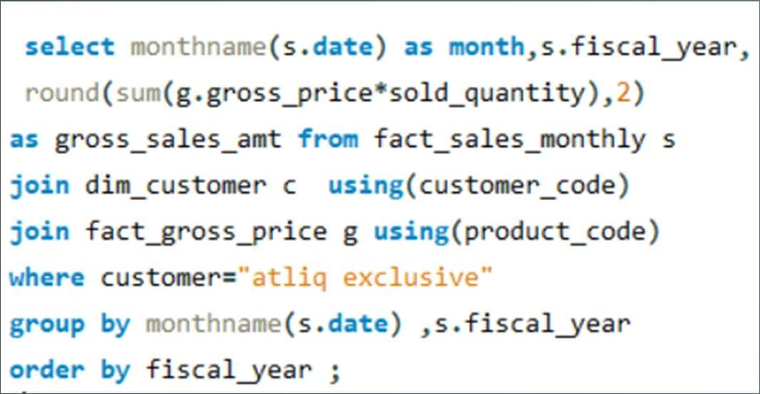
AD_HOC-REQUEST:7
Output
QUESTION:
Get the complete report of the Gross sales amount for the customer “Atliq Exclusive” for each month.This analysis helps to get an idea of low and high-performing months and take strategic decisions.The final report contains these columns: Month, Year, Gross sales Amount
SQL Query

Slide 14
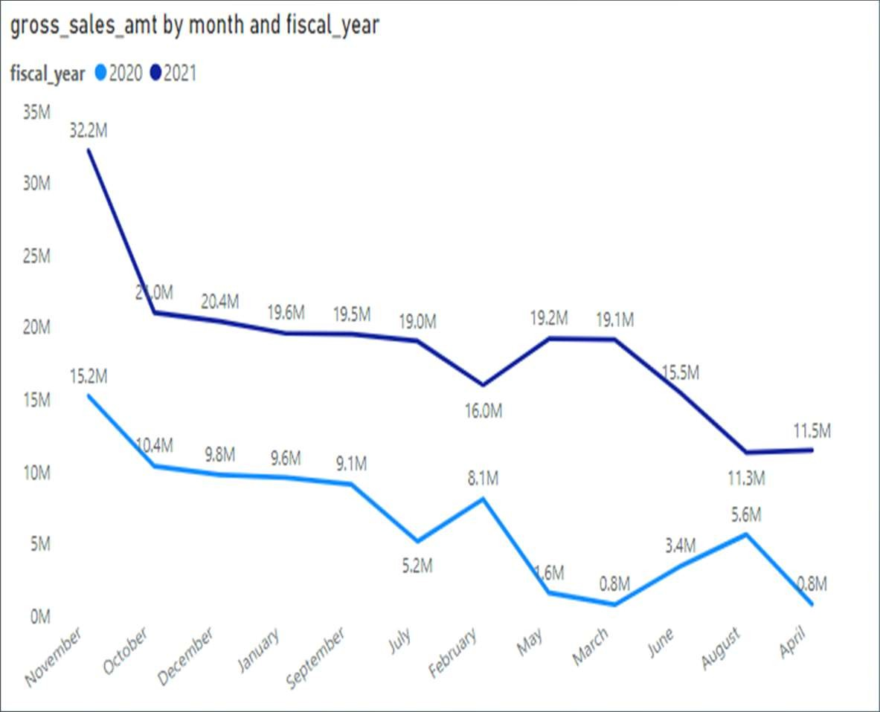
VISUALS-7
Insights
November 2021 had the highest gross sales amount, reaching $32,247,289.79.
In contrast, the fiscal year 2021 started with lower sales in September but still had a significant peak in November.
There is a notable seasonality in sales, with November being a consistently strong month.
The months of March and April in fiscal year 2020 had relatively low sales, which improved in fiscal year 2021.
These insights can guide strategic decisions, such as focusing marketing efforts and inventory planning around the peak sales months and addressing potential challenges during lower sales months.

Slide 15
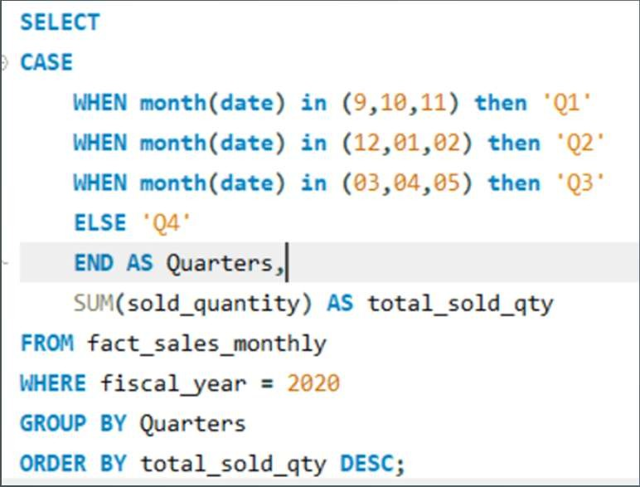
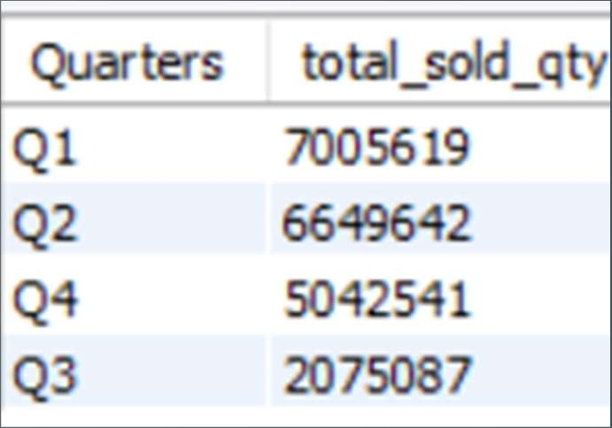
AD_HOC-REQUEST:8
QUESTION:
In which quarter of 2020, got the maximum total_sold_quantity? The final output contains these fields sorted by the total_sold_quantity, Quarter total_sold_quantity
SQL Query
Output

Slide 16
VISUALS-8
Insights
QUATERS VS TOTAL_SOLD_QTY
The highest total sold quantity is in Q1, with 7,005,619 units.
These insights highlight a seasonal variation in sales, with Q1 and Q2 being the strongest quarters and Q3 being the weakest.
This information is valuable for planning inventory and marketing strategies to align with seasonal demand
7005619
6649642
5042541
2075087
Q1
Q2
Q4
Q3

Slide 17
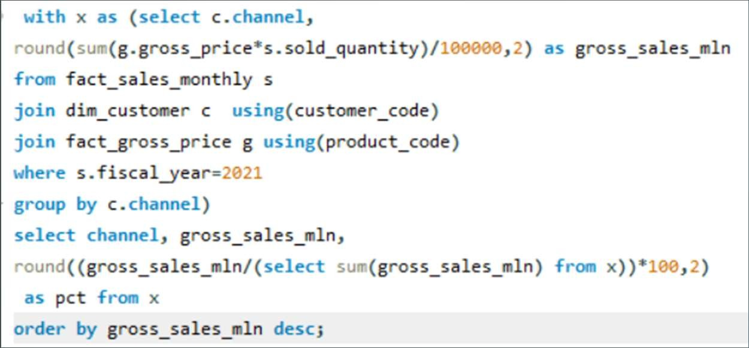
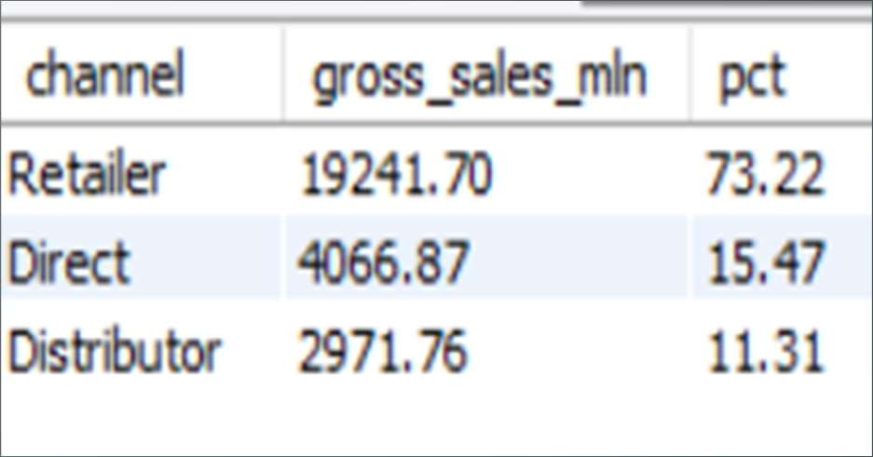
AD_HOC-REQUEST:9
QUESTION:
Which channel helped to bring more gross sales in the fiscal year 2021 and the percentage of contribution? The final output contains these fields channel, gross_sales_mln, percentage
SQL Query
Output

Slide 18
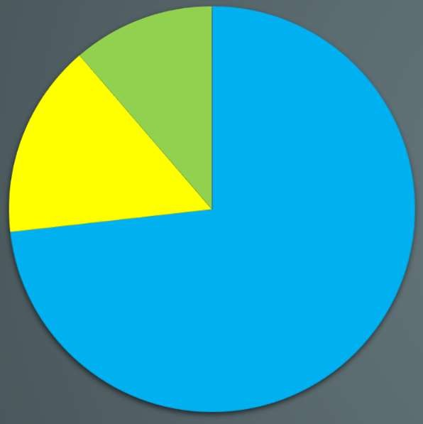
VISUALS 9
Insights
The "Retailer" channel accounts for the majority of sales, contributing to 73.22% of gross sales.
The "Direct" channel also plays a significant role, representing 15.47% of gross sales.
The "Distributor" channel contributes 11.31% of gross sales.
A significant focus on the "Retailer" channel suggests it is the primary revenue driver.
Diversification and growth opportunities may be explored in the "Direct" and "Distributor" channels to further maximize sales.
channel gross_sales contribution
2971.76,
11%
4066.87, 16%
19241.7, 73%
Retailer
Direct
Distributor

Slide 19
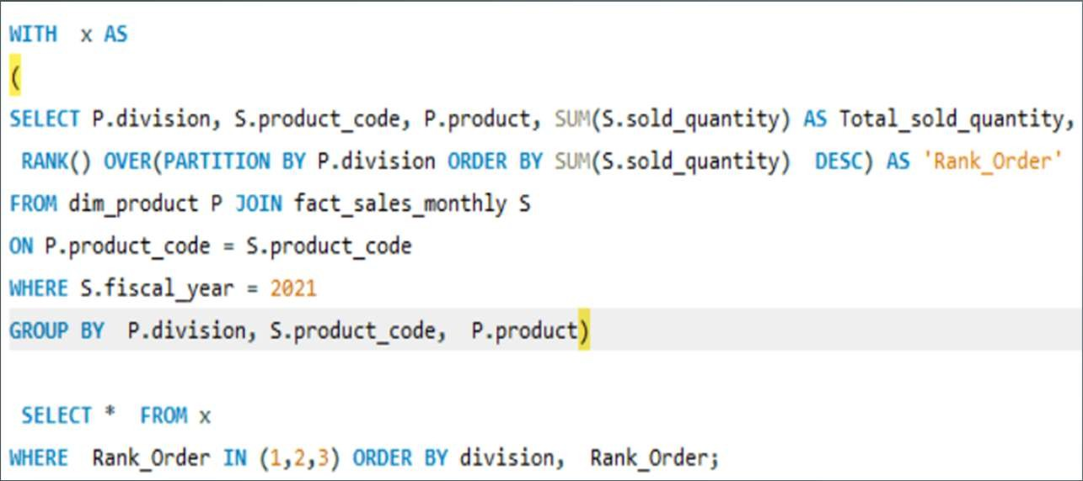
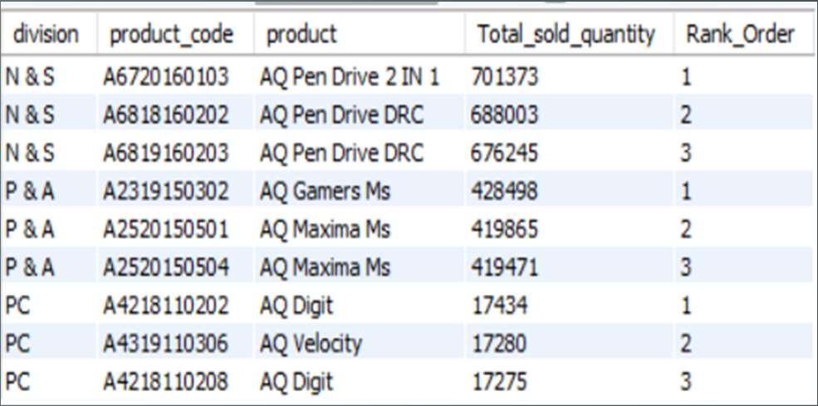
AD_HOC-REQUEST:10
QUESTION:
Get the Top 3 products in each division that have a high total_sold_quantity in the fiscal_year 2021? The final output contains these fields, division product_code
SQL Query
Output

Slide 20


VISUALS -10
Insights
Top 3 sold product in N&S Division
Total_sold_quantity Rank_Order
The top three products: "AQ Pen Drive 2 IN 1," "AQ Pen Drive DRC," and another variant of "AQ Pen Drive DRC."
Strong consumer preference for pen drives and related items in this division.
The division's leadership in this market segment, indicating growth potential.
Efficient inventory management is crucial for sustained success.
701373
688003
676245
1
2
3
AQ PEN DRIVE 2 IN 1 A6720160103
N & S
AQ PEN DRIVE DRC A6818160202
N & S
AQ PEN DRIVE DRC A6819160203
N & S

Slide 21


VISUALS -10
Insights
Top 3 sold product in P & A Division
428498
419865
419471
The best-selling product is "AQ Gamers Ms," followed by two variants of "AQ Maxima Ms."
This division specializes in gaming-related products, appealing to a specific customer niche..
Efficient inventory management is essential to meet customer demand.
Continuously promote and brand the top products to sustain success.
1
2
3
1 | 2 | 3
428498 | 419865 | 419471
AQ GAMERS MS | AQ MAXIMA MS | AQ MAXIMA MS
A2319150302 | A2520150501 | A2520150504
P & A | P & A | P & A
Total_sold_quantity
Rank_Order

Slide 22


VISUALS -10
Insights
Top 3 sold product in PC Division
The best-selling product in the "PC" division is "AQ Digit," with two variants followed by “AQ velocity”.
The division specializes in PC-related products, indicating a focus on the computing niche.
Efficient inventory management is essential to meet customer demand.
Ongoing branding and marketing efforts are important to maintain success.
17434
17280
17275
1
2
3
1 | 2 | 3
17434 | 17280 | 17275
AQ DIGIT | AQ VELOCITY | AQ DIGIT
A4218110202 | A4319110306 | A4218110208
PC | PC | PC
Total_sold_quantity
Rank_Order

